Slide 1

Smartphone Based Detection of Retinal Abnormalities
Rohaid Ahmed Mirza
Shakir Khan
M. Zain Zubair
FA19-BCE-006
FA19-BCE-008
FA19-BCE-027
Supervised By
Dr. Syed Saud Naqvi
Associate Professor
Dr. Haroon Ahmed Khan
Assistant Professor
Department of Electrical and Computer Engineering
COMSATS University Islamabad

Slide 2
Introduction
Block Diagram
Bibliography
Literature Review
Project Description
Agenda
Notes:
Image by freepik

Slide 3
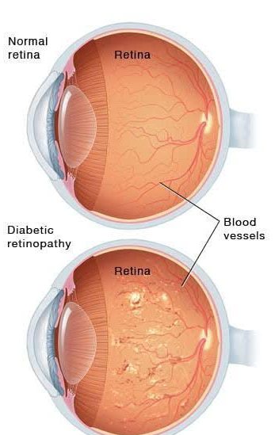
Introduction
People with Diabetes develop Diabetic Retinopathy (DR) that may lead to vision loss.
One of its early indicators is changes in retinal blood vessels’ structure.
DR is the leading cause of new cases of blindness in people with diabetes. [1]
In Pakistan, 27.4 million people above the age of 20 are affected by diabetes. [2]
[1] https://www.cdc.gov/visionhealth/pdf/factsheet.pdf
[2] Basit A, Fawwad A, Qureshi H NDSP Members, et al Prevalence of diabetes, pre-diabetes and associated risk factors: second National Diabetes Survey of Pakistan (NDSP), 2016–2017BMJ Open 2018;8:e020961. doi: 10.1136/bmjopen-2017-020961
Notes:
27.4 million people over the age of 20 (26.3% of this age group) are affected by diabetes – four times higher than in the 1998 survey.
(the light-sensitive layer of tissue in the back of your eye).

Slide 4
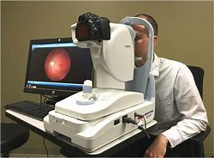
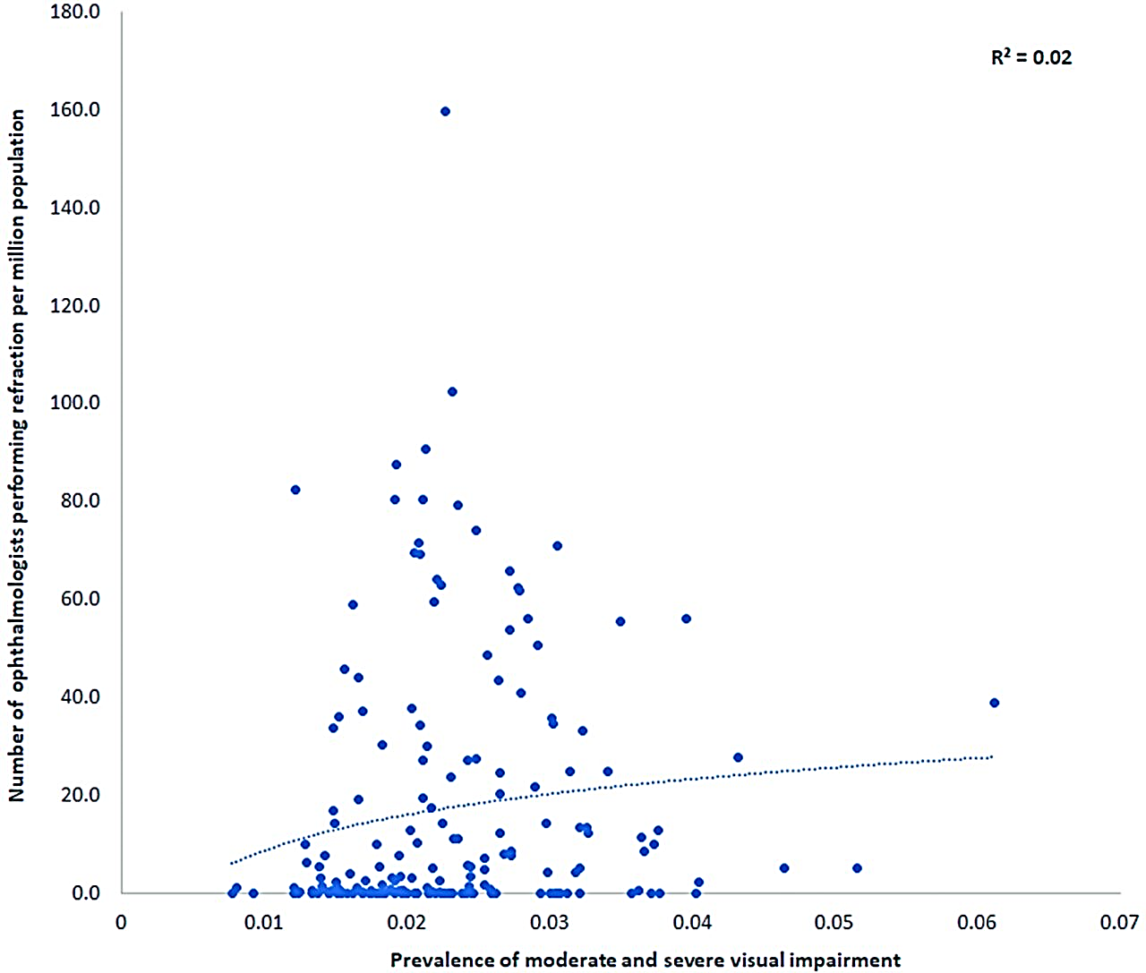
Introduction
Diagnosis of DR from Fundus images is typically done by large, unportable and expensive equipment
You need trained clinical specialists (ophthalmologists) to operate these types of equipment
There is a huge disparity between availability of equipment and specialists versus the number of patients
Notes:
Image by freepik

Slide 5
Introduction
A lot of current research is being carried out to automate this process without the equipment and the specialist
Diagnosis of DR from Fundus images is typically done by large, unportable and expensive equipment
You need trained clinical specialists (ophthalmologists) to operate these types of equipment
There is a huge disparity between availability of equipment and specialists versus the number of patients
Notes:
Image by freepik

Slide 6
Introduction
Automation reduces the manual errors and increases the efficiency of the system.
Automation on mobile makes the model/system portable to use anywhere anytime .
The goal is to take the automatic detection algorithm to the palm of hand.
Notes:
Image by freepik

Slide 7
Literature review
Research | Contributions
Detection of retinal abnormalities using Smartphone-captured fundus images: A survey (Mohamed Akil, Yaroub Elloumi) [3] | This study in enclose by a discussion where we report the requirement of normalized approach for fundus image capture, a well-defined preprocessing to fundus image enhancement and the implementation of machine learning on Smartphone to insure a local detection.
Comparison of smartphone-based retinal imaging systems for diabetic retinopathy detection using deep learning (Mahmut Karakaya & Recep E. Hacisoftaoglu ) [4] | This paper investigated the smartphone-based portable retinal imaging systems, namely iExaminer, D-Eye, Peek Retina, and iNview to compare their image quality.
[3] Mohamed Akil, Yaroub Elloumi. Detection of retinal abnormalities using Smartphone-captured fundus images: A survey. Real-Time Image Processing and Deep Learning, Apr 2019, Baltimore, Maryland, United States. ff10.1117/12.2519094ff. ffhal-02121855f
[4] Karakaya, M., Hacisoftaoglu, R.E. Comparison of smartphone-based retinal imaging systems for diabetic retinopathy detection using deep learning. BMC Bioinformatics 21 (Suppl 4), 259 (2020). https://doi.org/10.1186/s12859-020-03587-2

Slide 8
Literature review
Research | Contributions
CABnet: Category Attention Block for Imbalanced Diabetic retinopathy Grading (Along He, Tao Li , Ning Li, Kai Wang) [5] | CABNet combines category attention block (CAB) and global attention block (GAB). CABNet can be trained in an end-to-end manner for fine-grained DR grading and learn discriminative features by the attention module.
Comparison of automated and expert human grading of diabetic retinopathy using smartphone-based retinal photography (Tyson N. Kim, et al.) [6] | A smartphone-based camera was used by non-ophthalmic personnel to image the retina of diabetic patients. Images were independently evaluated by two masked readers and categorized as refer/no refer
[5] He, A., Li, T., Li, N., Wang, K. and Fu, H., 2020. CABNet: category attention block for imbalanced diabetic retinopathy grading. IEEE Transactions on Medical Imaging, 40(1), pp.143-153.
[6] Kim, T.N., Aaberg, M.T., Li, P. et al. Comparison of automated and expert human grading of diabetic retinopathy using smartphone-based retinal photography. Eye 35, 334–342 (2021). https://doi.org/10.1038/s41433-020-0849-5

Slide 9
Problem Statement
Misdiagnosis
Cost
Due to:
Lack of training or expertise of the ophthalmologist
Malpractice
Bear:
Medical specialist expense
Visit frequency

Slide 10
Proposed Solution
Automated Analysis
Grading
Captured image would be analyzed automatically by the mobile application.
The grading of the model would tell whether the level of pathology is referable to ophthalmologists or not.
Cost Saving
Doctor appointments’ fee and commute cost for every visit would be saved.
Smartphone in the pocket would replace the expensive fundus imaging cameras.

Slide 11
Project Description

Slide 12
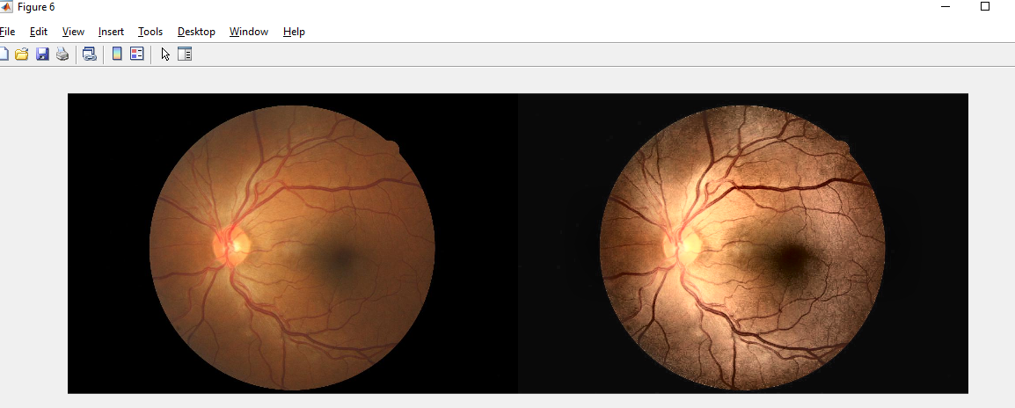
Block Diagram Smartphone Application
Server
Output
Recognition
Smart Phone
DR
Application
Diagnosis
Smart Phone Camera/Gallery
Retinal Image
Notes:
Image by freepik

Slide 13
Block Diagram Web Application
Server
Output
Recognition
Computer
DR Web
Application
Diagnosis
File Explorer
Retinal Image
Notes:
Image by freepik

Slide 14
Flow Chart
Image Acquisition
Server
False (Non-Retinal)
Network
Model 1
If retinal?
Retinal/Non-Retinal
Image
Application
True (Retinal)
Outcome
Server
Image
Network
Model 2
Referable/Non-Referable
Notes:
Image by freepik

Slide 15
Process Flow Diagram
Image Acquisition
DR Detection
Image Preprocessing
Model Training
Analysis
Noise Removal
Accuracy
Model Training
Resize
Specificity
Model Testing
Augmentation
Sensitivity
Notes:
Image by freepik

Slide 16
Artificial Neural Networks; Image Classifiers
Machine learning model inspired by the human brain's neural network structure.
Effective in image classification; ability to learn complex patterns and relationships within the data.
Can automatically extract relevant features from images, recognize and classify objects or patterns in images accurately
[7] T. Li, Y. Gao, K. Wang, S. Guo, H. Liu, and H. Kang, “Diagnostic assessment of deep learning algorithms for diabetic retinopathy screening,” Inf. Sci., vol. 501, pp. 511–522, Oct. 2019
Notes:
Image by freepik

Slide 17
Convolutional Neural Networks (CNN) over Simple ANN
Specialized type of ANN specifically designed for image processing and recognition tasks
Unique architectural elements such as convolutional layers, pooling layers, and fully connected layers
Optimized for image processing tasks, with improved performance and accuracy over simple ANN architectures
[7] T. Li, Y. Gao, K. Wang, S. Guo, H. Liu, and H. Kang, “Diagnostic assessment of deep learning algorithms for diabetic retinopathy screening,” Inf. Sci., vol. 501, pp. 511–522, Oct. 2019
Notes:
Image by freepik

Slide 18
Convolutional Neural Networks (CNN) over Simple ANN
Convolutional layers; apply filters, extract features from images preserving their spatial relationships
Pooling layers reduce the spatial dimensions of feature maps, enabling model to be invariant to small changes
Parameter and weight sharing across convolutional layers, learning spatial hierarchies of features efficiently
[7] T. Li, Y. Gao, K. Wang, S. Guo, H. Liu, and H. Kang, “Diagnostic assessment of deep learning algorithms for diabetic retinopathy screening,” Inf. Sci., vol. 501, pp. 511–522, Oct. 2019
Notes:
Image by freepik

Slide 19
Convolutional Neural Networks (CNN) over Simple ANN
Convolutional layers; apply filters, extract features from images preserving their spatial relationships
Pooling layers reduce the spatial dimensions of feature maps, enabling model to be invariant to small changes
Parameter and weight sharing across convolutional layers, learning spatial hierarchies of features efficiently
[7] T. Li, Y. Gao, K. Wang, S. Guo, H. Liu, and H. Kang, “Diagnostic assessment of deep learning algorithms for diabetic retinopathy screening,” Inf. Sci., vol. 501, pp. 511–522, Oct. 2019
Notes:
Image by freepik

Slide 20
Classification Networks
Two networks trained for the project
Network 1; Retinal Image Identification
One of the Two models proposed to be used; simple ANN or Mobilenetv2
No/less complex patterns to be detected
Network 2; DR Detection
Complex patterns to be trained on
MobileNetv2 used
[7] T. Li, Y. Gao, K. Wang, S. Guo, H. Liu, and H. Kang, “Diagnostic assessment of deep learning algorithms for diabetic retinopathy screening,” Inf. Sci., vol. 501, pp. 511–522, Oct. 2019
Notes:
Image by freepik

Slide 21
Network 1: Retinal Image Identification
Goal: Develop a classification model to identify between retinal images.
Dataset: Two classes - "non-retinal" (real-world images) and "retinal" (retinal images).
Training: Simple artificial neural network (ANN) architecture.
Alternative Approach: MobileNetV2 due to limitations on complex features.
[7] T. Li, Y. Gao, K. Wang, S. Guo, H. Liu, and H. Kang, “Diagnostic assessment of deep learning algorithms for diabetic retinopathy screening,” Inf. Sci., vol. 501, pp. 511–522, Oct. 2019
Notes:
Image by freepik

Slide 22
Network 2: DR Detection
Objective: Detect DR in retinal images
Training: Deep learning model trained on 18,000 retinal images from the EyePacs dataset
Classes: "Referable/DR" and "Non-Referable/No-DR" for disease classification
Knowledge Transfer: fine tuning on DDR dataset
[7] T. Li, Y. Gao, K. Wang, S. Guo, H. Liu, and H. Kang, “Diagnostic assessment of deep learning algorithms for diabetic retinopathy screening,” Inf. Sci., vol. 501, pp. 511–522, Oct. 2019
Notes:
Image by freepik

Slide 23
Dataset Acquisition
A dataset consisting of real-world images, including non retinal images, was used.
The dataset of random images was sourced from Kaggle.
Two datasets for retinal images:
EyePacs dataset;
Taken from “Kaggle Diabetic Retinopathy Detection Competition. Accessed: Apr. 11, 2020. [Online]”
Around 35000 retinal images
DDR dataset;
Taken from “Diagnostic assessment of deep learning algorithms for diabetic retinopathy screening,” by T. Li et. al. [7]
Around 12000 retinal images
[7] T. Li, Y. Gao, K. Wang, S. Guo, H. Liu, and H. Kang, “Diagnostic assessment of deep learning algorithms for diabetic retinopathy screening,” Inf. Sci., vol. 501, pp. 511–522, Oct. 2019
Notes:
Image by freepik

Slide 24
Dataset Acquisition
One data set for real-world images say non retinal
Random images dataset; Taken from kaggle
Two datasets for retinal images:
EyePACS dataset;
taken from “Kaggle Diabetic Retinopathy Detection Competition. Accessed: Apr. 11, 2020. [Online]”
Around 35000 retinal images
DDR dataset;
taken from “Diagnostic assessment of deep learning algorithms for diabetic retinopathy screening,” by T. Li et. al. [7]
around 12000 retinal images
Label | Grading Name
0 | No DR
1 | Mild DR
2 | Moderate DR
3 | Severe DR
4 | Proliferative DR
[7] T. Li, Y. Gao, K. Wang, S. Guo, H. Liu, and H. Kang, “Diagnostic assessment of deep learning algorithms for diabetic retinopathy screening,” Inf. Sci., vol. 501, pp. 511–522, Oct. 2019
Notes:
Image by freepik

Slide 25
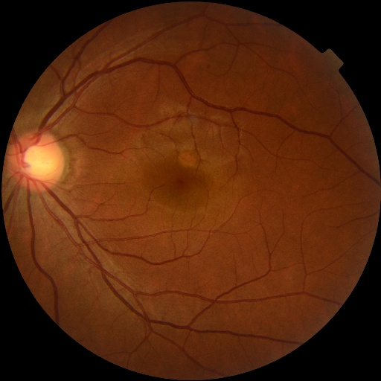
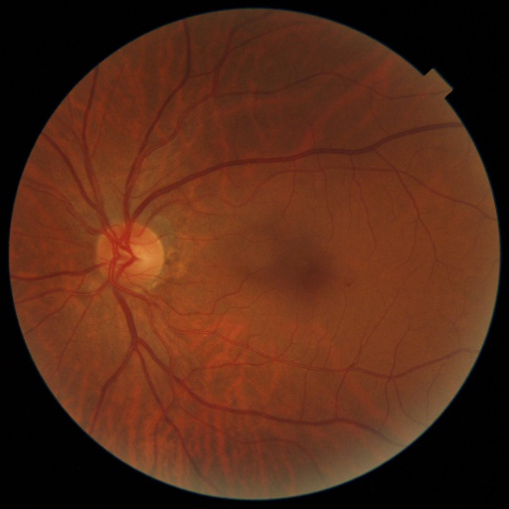
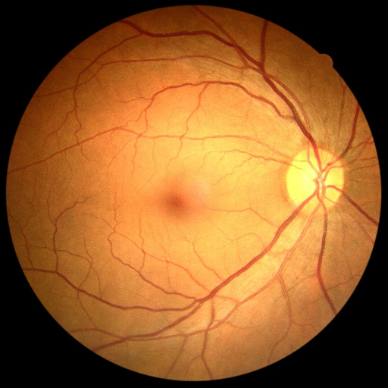
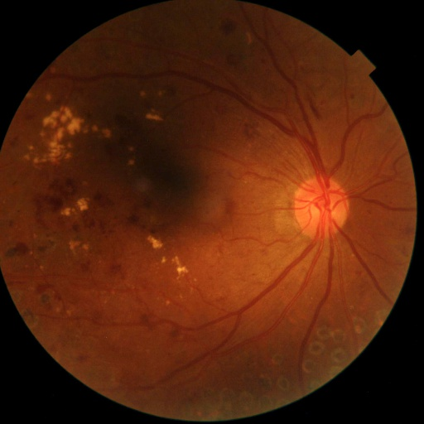
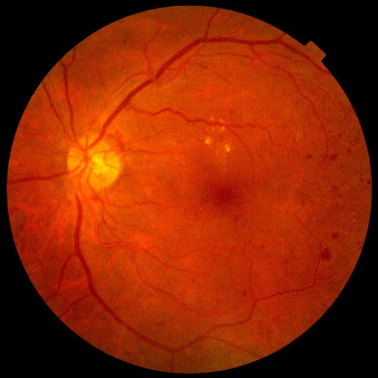
Dataset Acquisition
One data set for real-world images say non retinal
Random images dataset; Taken from kaggle
Two datasets for retinal images:
EyePACS dataset;
taken from “Kaggle Diabetic Retinopathy Detection Competition. Accessed: Apr. 11, 2020. [Online]”
Around 35000 retinal images
DDR dataset;
taken from “Diagnostic assessment of deep learning algorithms for diabetic retinopathy screening,” by T. Li et. al. [7]
around 12000 retinal images
Label | Grading Name
0 | No DR
1 | Mild DR
2 | Moderate DR
3 | Severe DR
4 | Proliferative DR
a
b
c
(a) No DR; (b) Mild DR; (c) Moderative DR; (d) Severe DR; (e) Proliferative DR;
d
e
[7] T. Li, Y. Gao, K. Wang, S. Guo, H. Liu, and H. Kang, “Diagnostic assessment of deep learning algorithms for diabetic retinopathy screening,” Inf. Sci., vol. 501, pp. 511–522, Oct. 2019
Notes:
Image by freepik

Slide 26
Data Preparing
Both models trained for two classes
Original datasets to be prepared according to required tasks:
Network 1 for retinal image identification
Non retinal images include random real-world images
Retinal images
Network 2 for DR detection
Non-Referable refer to no DR
Referable refer to DR
Network Models | Label
Network Model 1 | Non-Retinal
1 | Retinal
Network Models | Label
Network Model 2 | Non-Referable (No DR)
1 | Referable (DR)
Notes:
Image by freepik

Slide 27
Image Pre-processing
Developed by former Kaggle competition winner Ben’s Graham
Used for DR detection
Crop dark regions and resize image
Notes:
Image by freepik

Slide 28
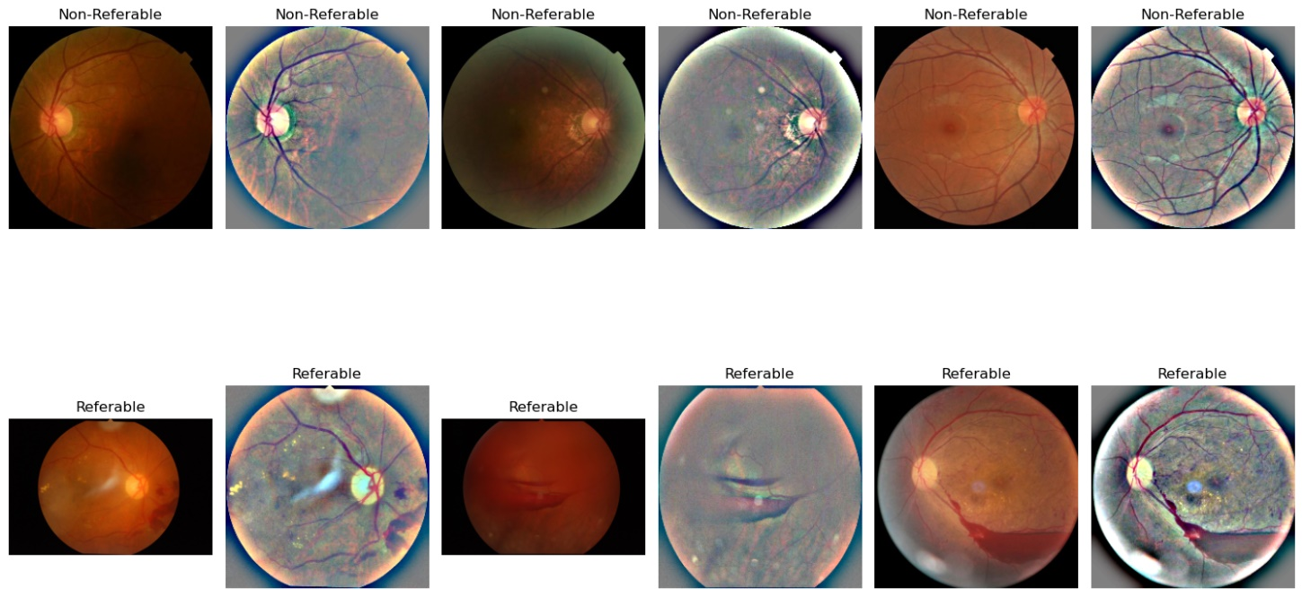

Bens Graham Preprocessing Technique
combines the original image and its Gaussian blur
enhance edges and features
Figure: Images Before and After Applying Ben Graham's Preprocessing
[8] Wang S, Zheng J, Hu HM, Li B. Naturalness preserved enhancement algorithm for non-uniform illumination images. IEEE Trans Image Process. 2013 Sep;22(9):3538-48. doi: 10.1109/TIP.2013.2261309. Epub 2013 May 2. PMID: 23661319.
Notes:
Image by freepik

Slide 29

Model Training
Preprocessing complete
Data trained on the following model using TensorFlow:
MobilenetV2
MobileNetV2; a popular convolutional neural network (CNN) architecture
designed for efficient computation on smartphones
lightweight model, achieves high accuracy
Minimizes computational resources and memory footprint.
Offers a good balance between model size, inference speed, and accuracy,
Notes:
Image by freepik

Slide 30
Model Training
Preprocessing complete
Data trained on the following models using TensorFlow:
MobilenetV2; both tasks
Simple ANN; retinal image identification
Notes:
Image by freepik

Slide 31
Model Training
Preprocessing complete
Data trained on the following models using TensorFlow:
MobilenetV2; both tasks
Simple ANN; retinal image identification
Notes:
Image by freepik

Slide 32
Model Training
MobileNetv2; a popular convolutional neural network (CNN) architecture
Designed for efficient computation on smartphones
Lightweight model, achieves high accuracy
Minimizes computational resources and memory footprint.
Offers a good balance between model size, inference speed, and accuracy,
Notes:
Image by freepik

Slide 33
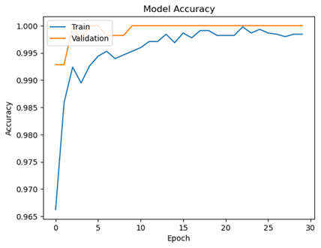
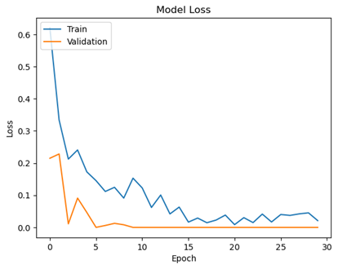
Network 1 Model Training
The model is trained on ANN architecture
Accuracy and loss for retinal image identification
Notes:
Image by freepik

Slide 34
Network 1 Model Training
 | Precision | Recall | F1-Score | Support
Non-Retinal Image | 1.0 | 1.0 | 1.0 | 2340
Retinal image | 1.0 | 1.0 | 1.0 | 2405
Accuracy |  |  | 1.0 | 4745
The model is trained on ANN architecture
Accuracy and loss for retinal image identification
Notes:
Image by freepik

Slide 35
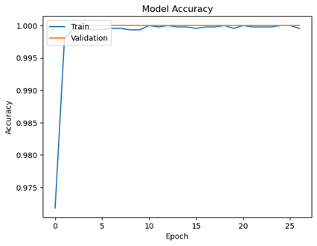
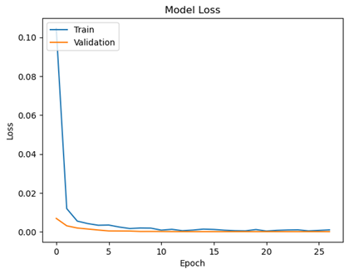
Network 1 Model Training
The model is trained on MobileNetV2
Accuracy and loss for retinal image identification
Notes:
Image by freepik

Slide 36
Network 1 Model Training
 | Precision | Recall | F1-Score | Support
Non-Retinal Image | 1.0 | 1.0 | 1.0 | 2340
Retinal image | 1.0 | 1.0 | 1.0 | 2405
Accuracy |  |  | 1.0 | 4745
The model is trained on MobileNetV2
Accuracy and loss for retinal image identification
Notes:
Image by freepik

Slide 37
Network 1 Model Training
MobileNetV2 model demonstrates superior performance
MobileNetV2 chosen over the simple ANN architecture
Notes:
Image by freepik

Slide 38
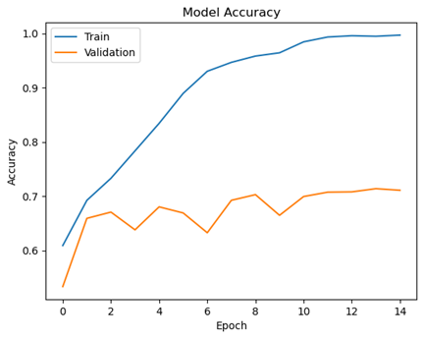
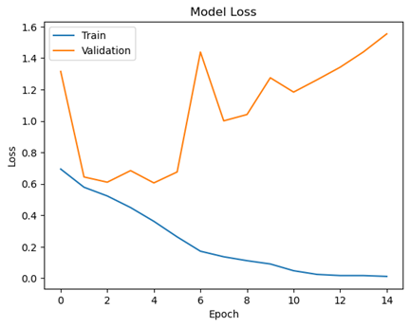
Network 2 Model Training
Accuracy and loss for DR detection.
Trained on EyePacs dataset.
Applied Ben’s Graham Preprocessing Technique.
Validated on DDR dataset.
Without fine tuning
Notes:
Image by freepik

Slide 39
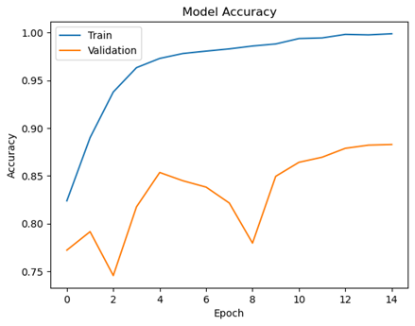
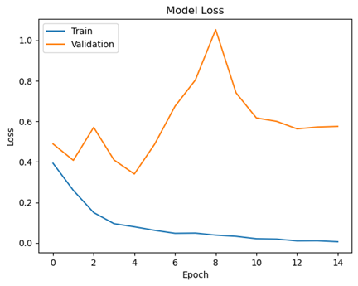
Model Training
Network 2 Fine Tuning Model
Accuracy and loss for DR detection
Trained on EyePACS
Without fine tuning on DDR
Accuracy and loss for DR detection.
Applied Ben’s Graham Preprocessing Technique.
Fine tuned on DDR dataset.
Notes:
Image by freepik

Slide 40

API Generation
Flask:
Python framework
For API generation
Model deployed on server
API is used for communication with server
Notes:
Image by freepik

Slide 41
Model Deployment
Python code written with flask framework
Pushed to server
API generated by server and flask
Application communicate with server using API
Notes:
Image by freepik

Slide 42

Mobile Application
Flutter:
Mobile application for the project is developed on Flutter framework.
Dart as programming language
Designed to maintain UI design uniformity across platforms
Notes:
Image by freepik

Slide 43
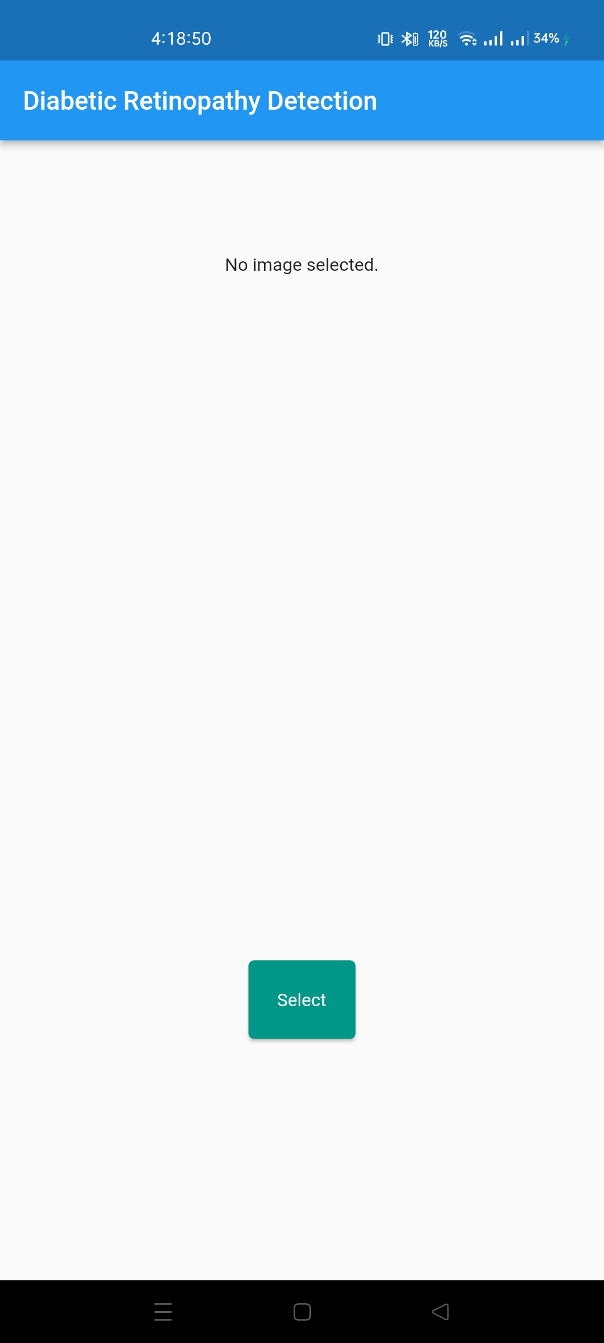
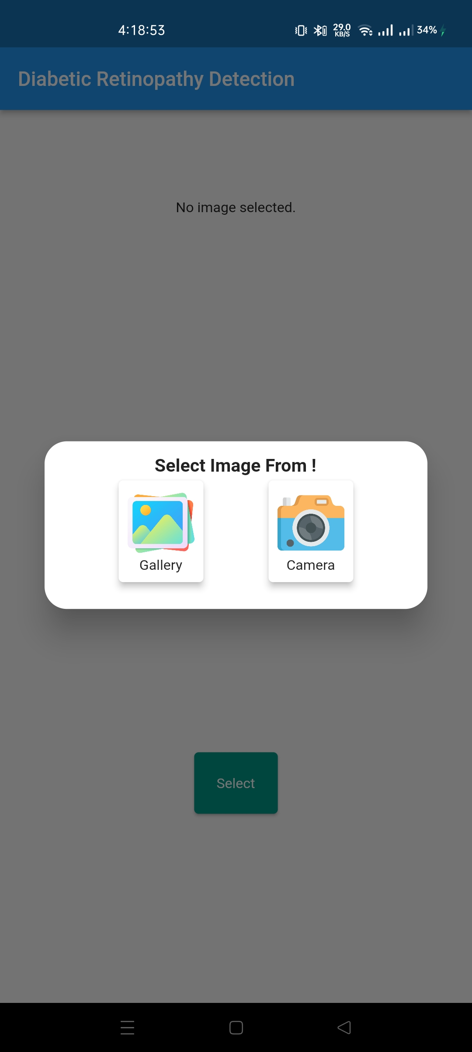
Mobile Application
Two options are provided for selecting the image
Image is either selected from gallery or is captured through camera
Flutter provides image_picker package to access gallery or camera
Notes:
Image by freepik

Slide 44
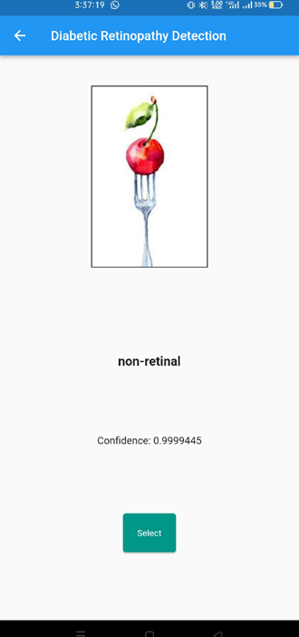
Mobile Application
Network Model deployed on server connected through API
The first network takes the selected image and classifies it as retinal or non retinal image
If not retinal , another image is to be selected
Notes:
Image by freepik

Slide 45
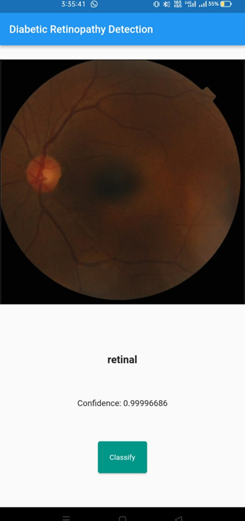
Mobile Application
Network Model deployed on server connected through API
The first network takes the selected image and classifies it as retinal or non retinal image
If retinal, image is passed to second network
Notes:
Image by freepik

Slide 46
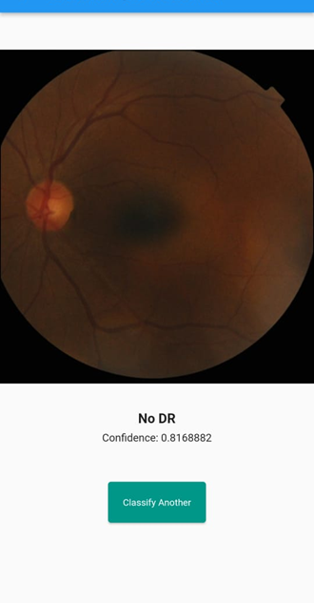
Mobile Application
Network Model deployed on server connected through API
The second network takes the retinal image and detects DR
Notes:
Image by freepik

Slide 47
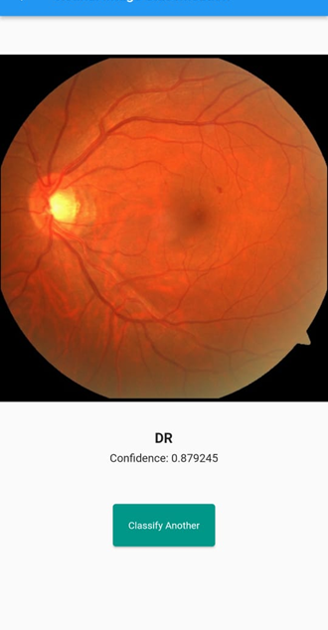
Mobile Application
Network Model deployed on server connected through API
The second network takes the retinal image and detects DR
Notes:
Image by freepik

Slide 48
Web Application
React JS:
Web application for the project is developed on React JS.
An open-source JavaScript library developed by Facebook
Enables the creation of highly responsive and interactive user interfaces
Notes:
Image by freepik

Slide 49
Web Application
Already saved image can be selected
Browse for the image and select
S
S
S
Notes:
Image by freepik

Slide 50
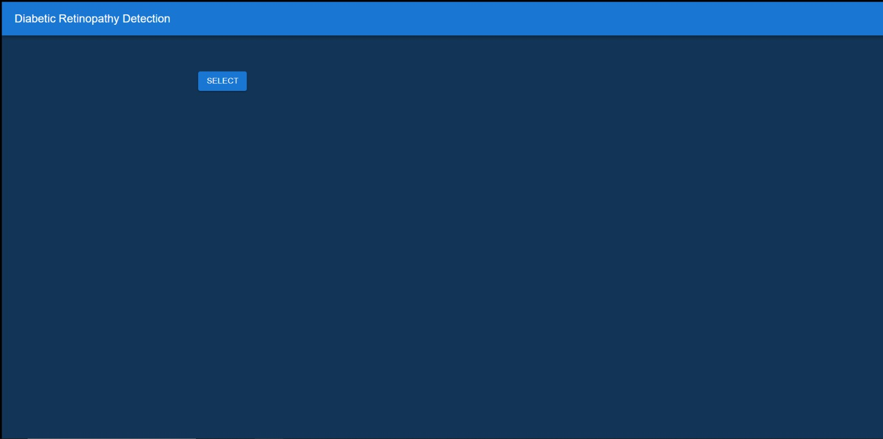
Web Application
Already saved image can be selected
Browse for the image and select
S
S
S
Notes:
Image by freepik

Slide 51
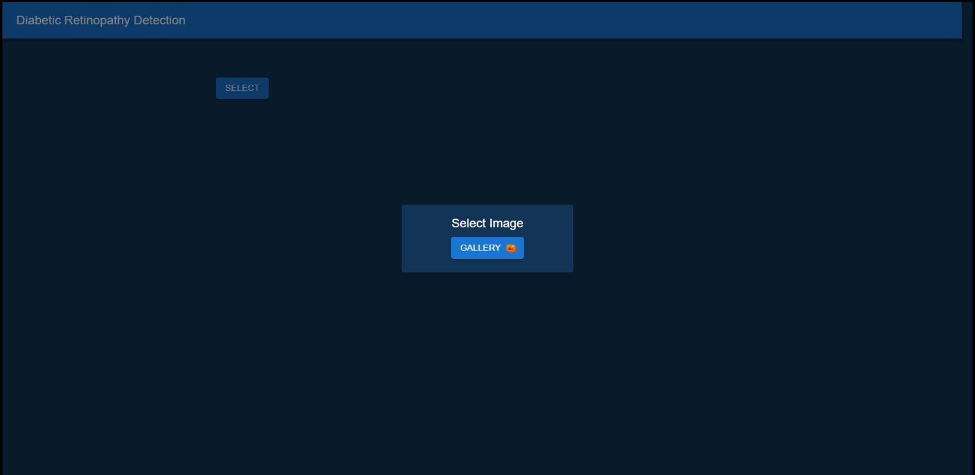
Web Application
Already saved image can be selected
Browse for the image and select
S
S
S
Notes:
Image by freepik

Slide 52
Web Application
Network Model deployed on server connected through API
The first network takes the selected image and classifies it as retinal or non retinal image
If not retinal , another image is to be selected
If retinal, image is passed to second network
Notes:
Image by freepik

Slide 53
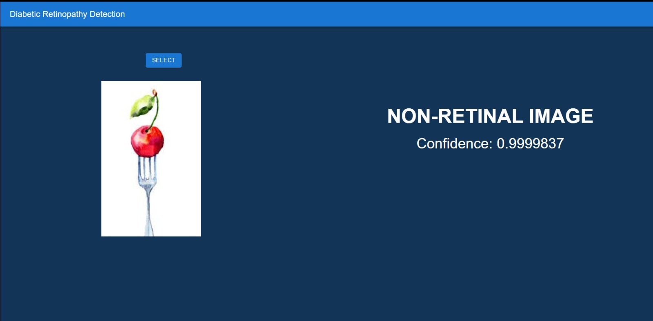
Web Application
Network Model deployed on server connected through API
The first network takes the selected image and classifies it as retinal or non retinal image
If not retinal , another image is to be selected
Notes:
Image by freepik

Slide 54
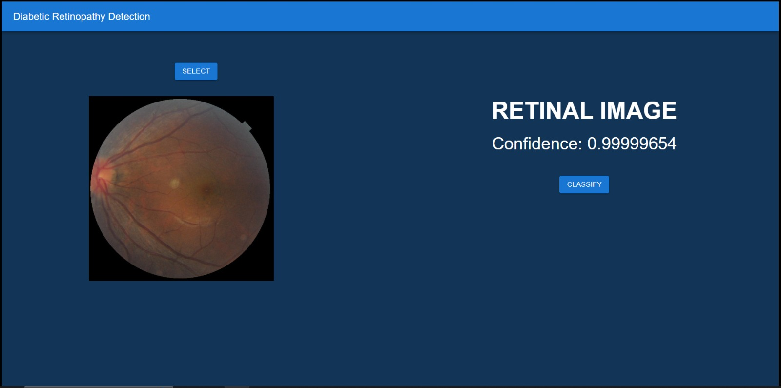
Web Application
Network Model deployed on server connected through API
The first network takes the selected image and classifies it as retinal or non retinal image
If not retinal , another image is to be selected
Notes:
Image by freepik

Slide 55
Web Application
Network Model deployed on server connected through API
The second network takes the retinal image and detects DR
Notes:
Image by freepik

Slide 56
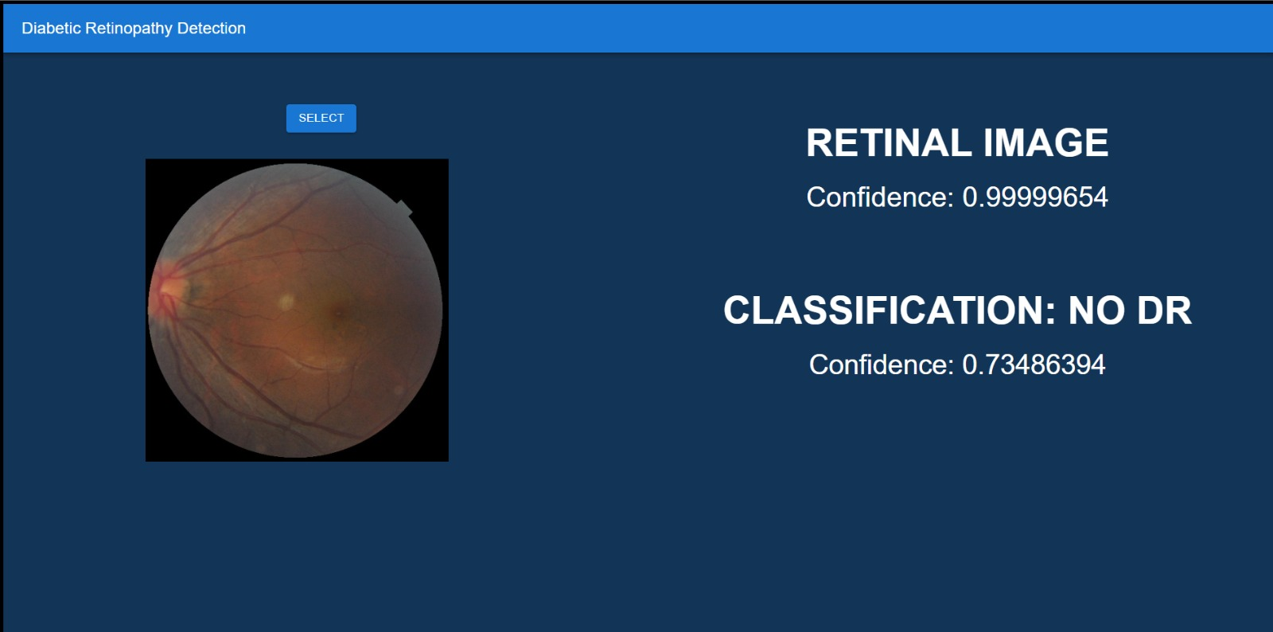
Web Application
Network Model deployed on server connected through API
The second network takes the retinal image and detects DR
Notes:
Image by freepik

Slide 57
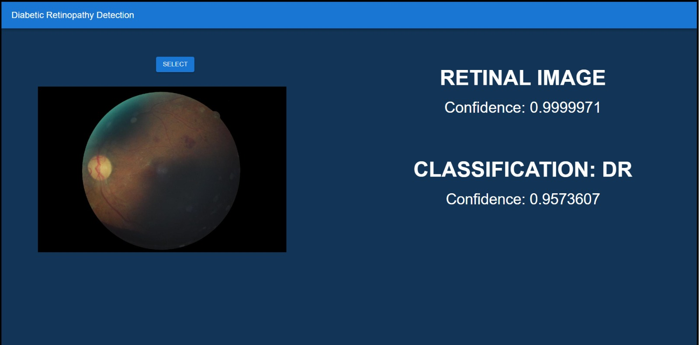
Web Application
Network Model deployed on server connected through API
The second network takes the retinal image and detects DR
Notes:
Image by freepik

Slide 58
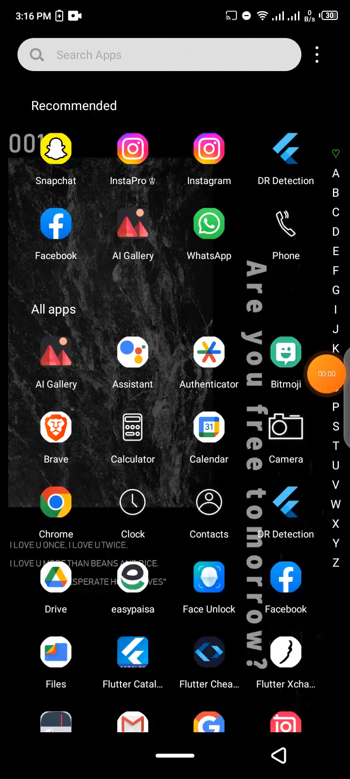
Demonstration
Smartphone Application
Notes:
Image by freepik

Slide 59
Demonstration
Web Application
Notes:
Image by freepik

Slide 60
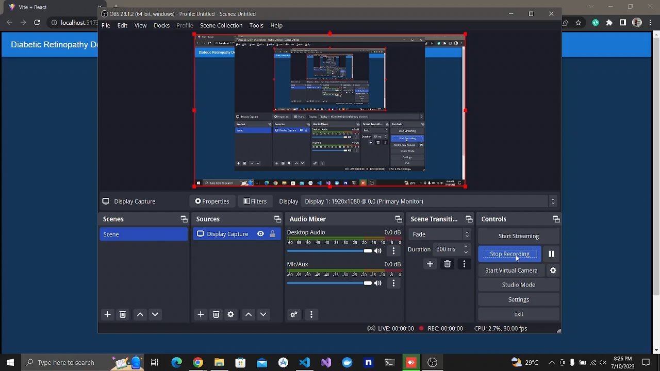
Demonstration
Web Application
Notes:
Image by freepik

Slide 61
Bibliography
Hehttps://www.cdc.gov/visionhealth/pdf/factsheet.pdf
Basit A, Fawwad A, Qureshi H NDSP Members, et al Prevalence of diabetes, pre-diabetes and associated risk factors: second National Diabetes Survey of Pakistan (NDSP), 2016–2017BMJ Open 2018;8:e020961. doi: 10.1136/bmjopen-2017-020961
Mohamed Akil, Yaroub Elloumi. Detection of retinal abnormalities using Smartphone-captured fundus images: A survey. Real-Time Image Processing and Deep Learning, Apr 2019, Baltimore, Maryland, United States. ff10.1117/12.2519094ff. ffhal-02121855f
Karakaya, M., Hacisoftaoglu, R.E. Comparison of smartphone-based retinal imaging systems for diabetic retinopathy detection using deep learning. BMC Bioinformatics 21 (Suppl 4), 259 (2020). https://doi.org/10.1186/s12859-020-03587-2
He, A., Li, T., Li, N., Wang, K. and Fu, H., 2020. CABNet: category attention block for imbalanced diabetic retinopathy grading. IEEE Transactions on Medical Imaging, 40(1), pp.143-153.
Kim, T.N., Aaberg, M.T., Li, P. et al. Comparison of automated and expert human grading of diabetic retinopathy using smartphone-based retinal photography. Eye 35, 334–342 (2021). https://doi.org/10.1038/s41433-020-0849-5
T. Li, Y. Gao, K. Wang, S. Guo, H. Liu, and H. Kang, “Diagnostic assessment of deep learning algorithms for diabetic retinopathy screening,” Inf. Sci., vol. 501, pp. 511–522, Oct. 2019
[8] Wang S, Zheng J, Hu HM, Li B. Naturalness preserved enhancement algorithm for non-uniform illumination images. IEEE Trans Image Process. 2013 Sep;22(9):3538-48. doi: 10.1109/TIP.2013.2261309. Epub 2013 May 2. PMID: 23661319.
[9] Zuiderveld, Karel J.. “Contrast Limited Adaptive Histogram Equalization.” Graphics gems (1994).

Slide 62
Thank You
Notes:
Image by freepik

